Slide 1
Chassis and Body Design and Manufacturing
Group Project
GROUP 11
Lorenzo Coliva
Matteo Fratini
Luca Gabrielli
Marco Marcaccini
Martina Novi
Chiara Suozzi

Slide 2
THE DESIGN PROCESS
MATERIALS AND BC’S
STATIC ANALYSIS
FATIGUE ANALYSIS
TOPOLOGY OPTIMIZATION
SCREWS VERIFICATION
MANUFACTURING PROCESS

Slide 3
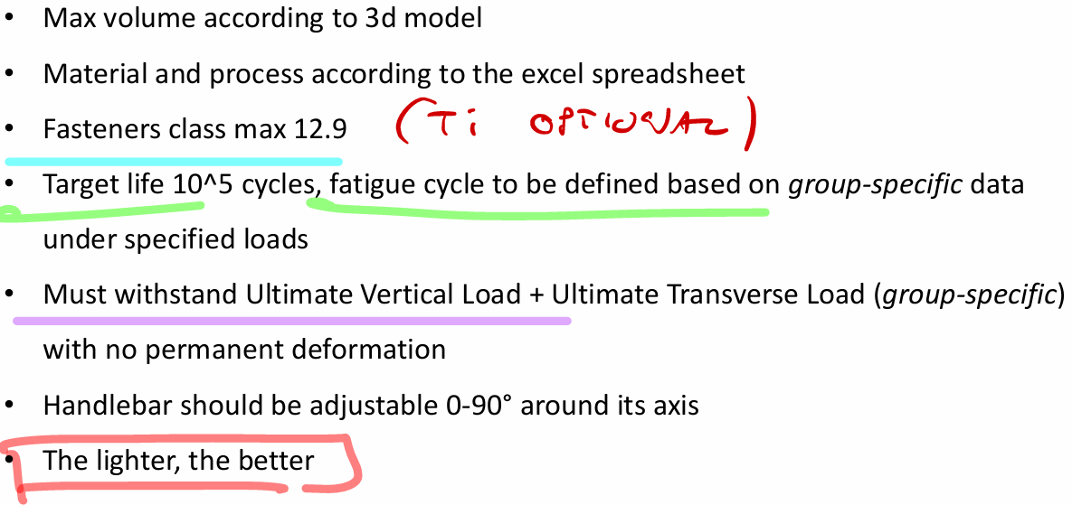
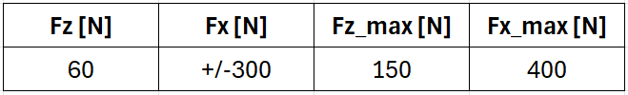
MATERIALS AND BC’S
The objective of the project is to design an adjustable handlebar bracket for a supersport motorbike according to the assigned boundary conditions.

Slide 4
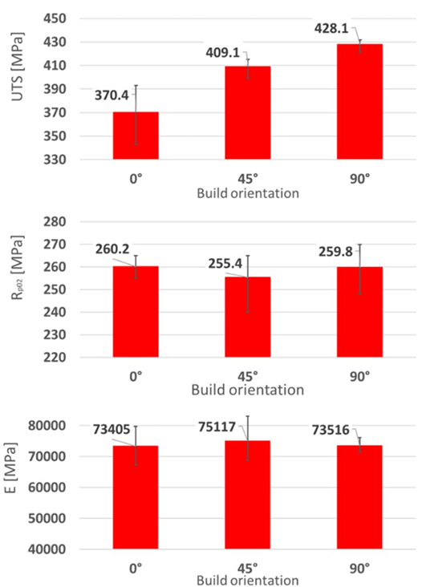
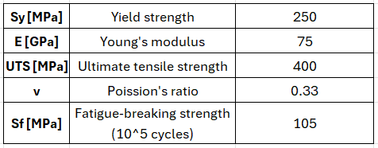
MATERIALS AND BC’S
The material of the bracket is AlSi10Mg additive.
It has been characterized using the following values, assuming a 45° printing direction.
We used a T6 heat treatment and a surface treatment with a micro-shot peening.

Slide 5
THE DESIGN PROCESS
MATERIALS AND BC’S
TOPOLOGY OPTIMIZATION

Slide 6
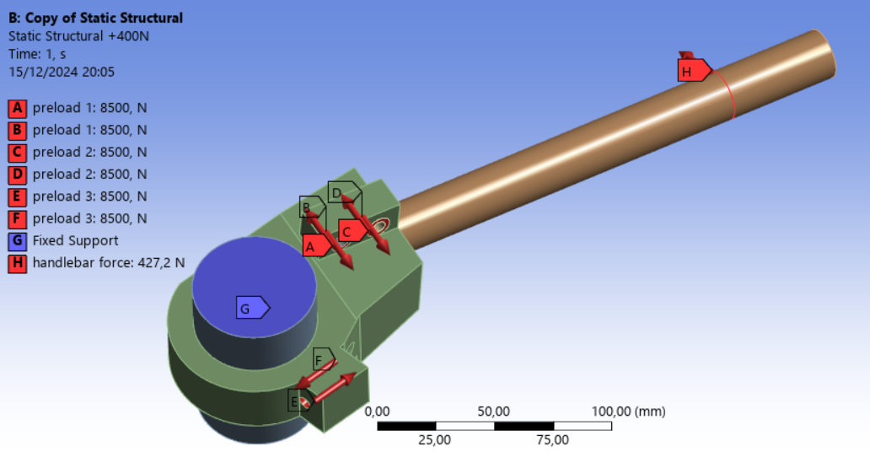
TOPOLOGY OPTIMIZATION
The topology optimization was performed using the ultimate loads Fz and Fx (this one in both + and – directions to resist during fatigue).
To simulate the pretension of the screws, two opposite linear loads corresponding to the maximum assembly screw force were applied in the underhead and threaded faces.
The underhead and contact regions were set as exclusions.

Slide 7
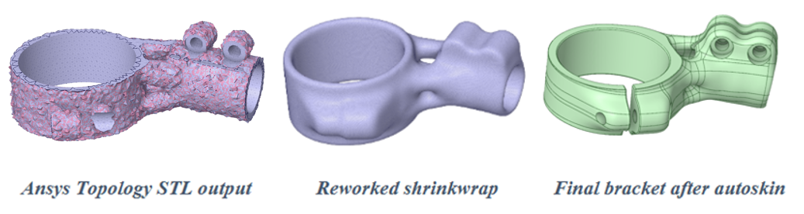
TOPOLOGY OPTIMIZATION
The topology output using a mass retain of 5% minimizing compliance is showed below.
Then it was reconstructed using Spaceclaim to obtain a smooth geometry preventing stress intensifications.
Finally, the holes and the screws slots were refined.

Slide 8
THE DESIGN PROCESS
MATERIALS AND BC’S
STATIC ANALYSIS
TOPOLOGY OPTIMIZATION

Slide 9
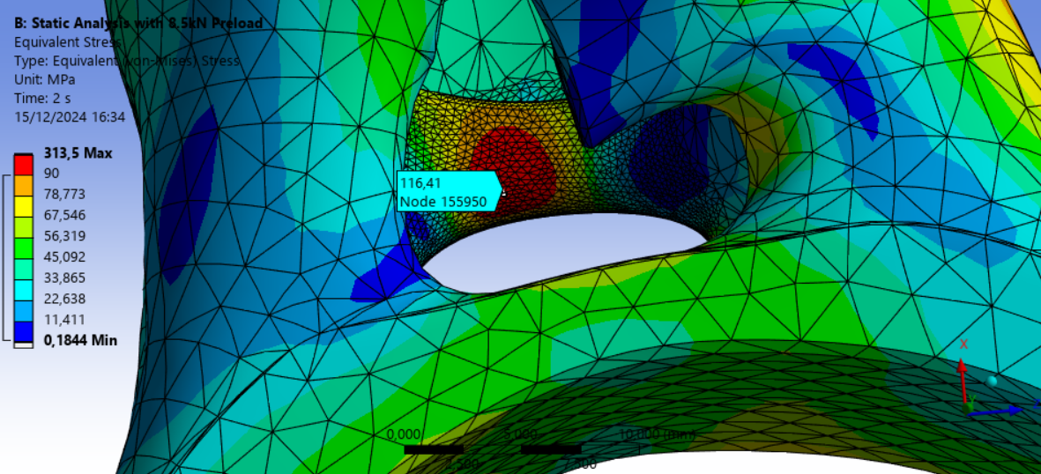
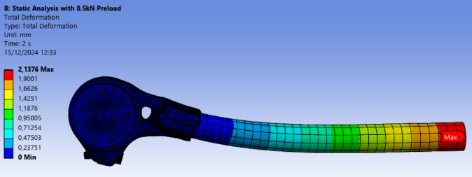
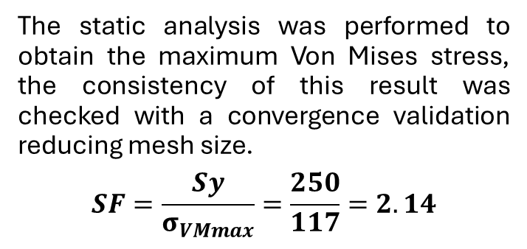
STATIC ANALYSIS
The static analysis was performed to obtain the maximum Von Mises stress, the consistency of this result was checked with a convergence validation reducing mesh size.
$$SF=\frac{Sy}{σ_{VMmax}}=\frac{250}{117}=2.14$$
Handlebar displacement:
To avoid an uncomfortable steering, the maximum handlebar deflection has been verified, giving a result of 2.14 [mm] which is more than acceptable under the static limit load.

Slide 10
THE DESIGN PROCESS
MATERIALS AND BC’S
STATIC ANALYSIS
TOPOLOGY OPTIMIZATION
SCREWS VERIFICATION

Slide 11
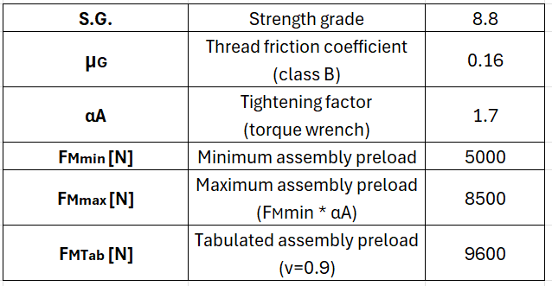
SCREWS VERIFICATION
The screw choice was made based on existing similar components, selecting a preload on VDI 2230 table A1 and verifying on Ansys that the minimum preload was enough to avoid slipping of the clamp and to limit the stress generated by the handlebar. Three M6 – 8.8 socket head cap screws have been chosen.
Screw 1 (stanchion clamp): M6 x 35 – 8.8 – ISO 4762
Screw 2 and 3 (handlebar clamp): M6 x 20 – 8.8 – ISO 4762

Slide 12
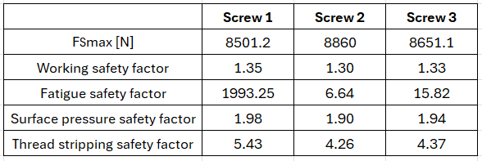
SCREWS VERIFICATION
The screws verification was performed using the VDI approach, the maximum working load at the final time was obtained from the Ansys static analysis using maximum preload.
The minimum length of engagement for AlSi10Mg is 7.5 mm (1.25*d) so 9 mm and 11 mm are used for safety.
The tightening torque is 6950 [N*mm].

Slide 13
THE DESIGN PROCESS
MATERIALS AND BC’S
STATIC ANALYSIS
FATIGUE ANALYSIS
TOPOLOGY OPTIMIZATION
SCREWS VERIFICATION

Slide 14
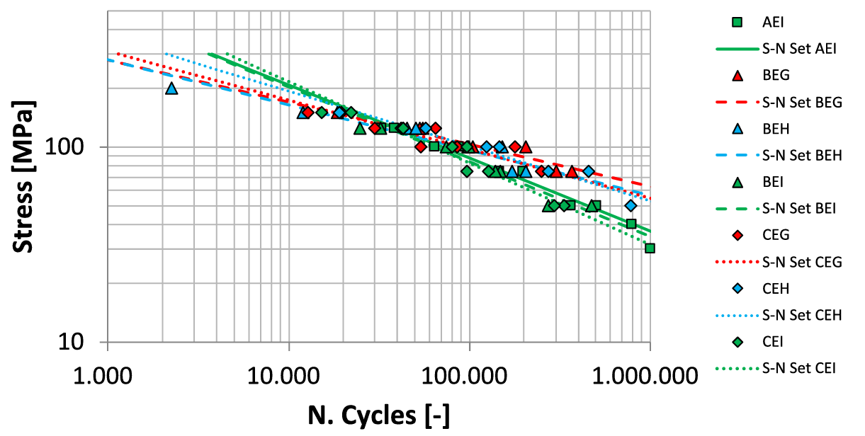
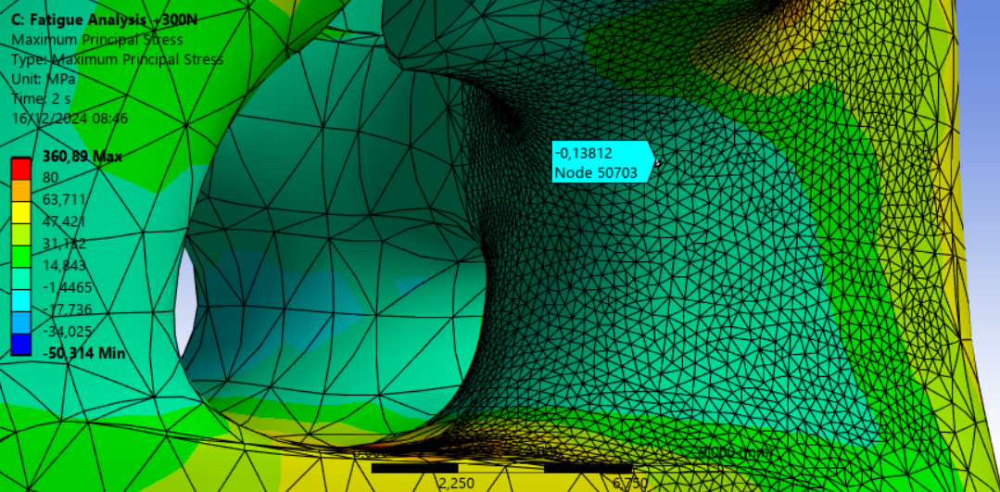
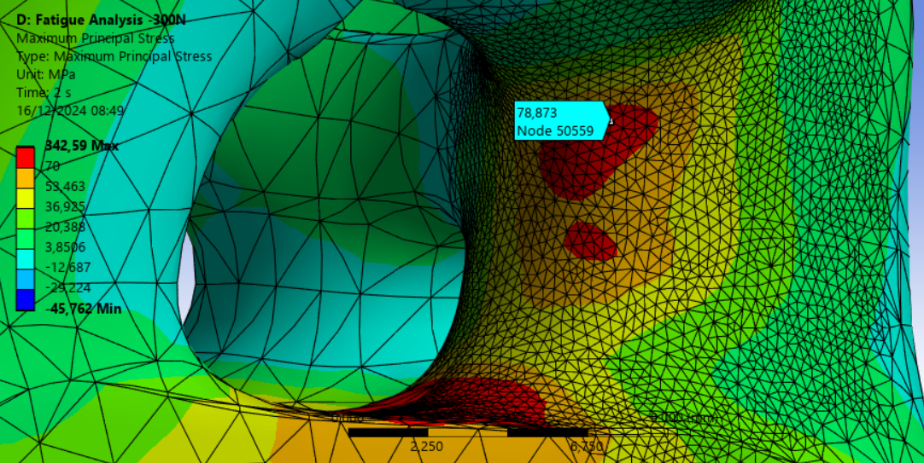
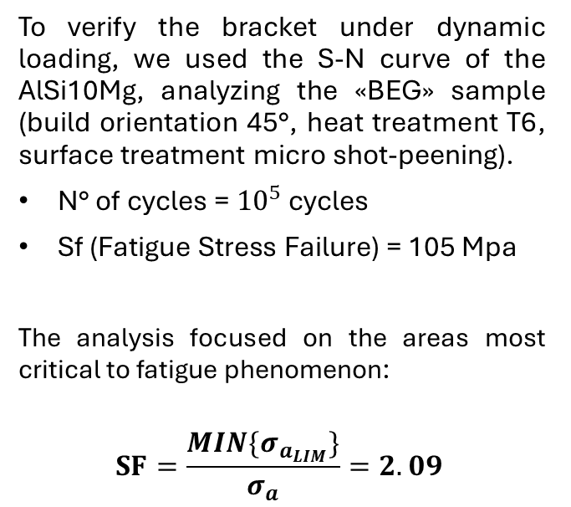
FATIGUE ANALYSIS
To verify the bracket under dynamic loading, we used the S-N curve of the AlSi10Mg, analyzing the «BEG» sample (build orientation 45°, heat treatment T6, surface treatment micro shot-peening).
N° of cycles = ${10}^{5}$ cycles
Sf (Fatigue Stress Failure) = 105 Mpa
The analysis focused on the areas most critical to fatigue phenomenon:
$$SF=\frac{MIN\{σ_{a_{LIM}}\}}{σ_{a}}=2.09$$

Slide 15
THE DESIGN PROCESS
MATERIALS AND BC’S
STATIC ANALYSIS
FATIGUE ANALYSIS
TOPOLOGY OPTIMIZATION
SCREWS VERIFICATION
MANUFACTURING PROCESS

Slide 16
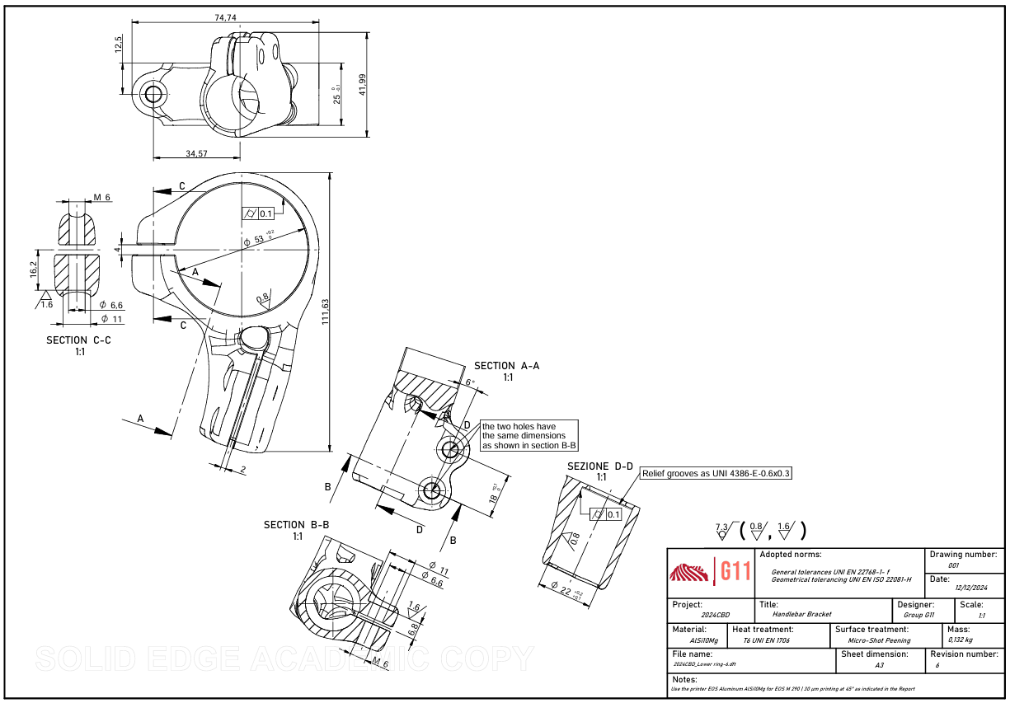
MANUFACTURING PROCESS
Technical drawing:
General surface roughness BEG: Ra = 7.3 μm
Mating surfaces with stanchion and handlebar: clearance fit permitting manual insertion, cylindricity, Ra = 0.8 μm
Screws underhead bearing surfaces: Ra = 1.6 μm

Slide 17
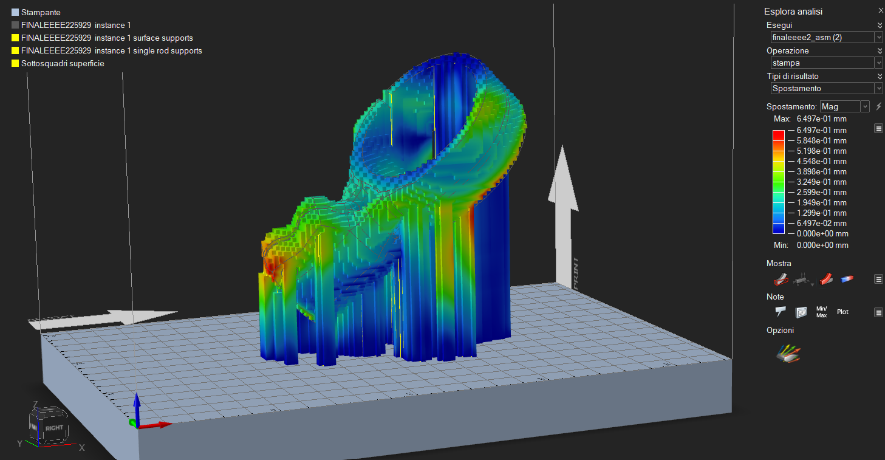
MANUFACTURING PROCESS
Printing process:
In conclusion, we simulated a manufacturing process using Altair Inspire.
To minimize deformations after printing, we analyzed the thermal map, to find a balance between time, support material and deformations.
The following configuration at 45° minimized the deformations, obtaining a value of 0.65 mm.
The required printing time is about 4.30 hours, after that T6 heat treatment and micro shot-peening are performed to improve mechanical properties.
The last process is a CNC machining to refine the mating surfaces, the relief groove and the threaded holes.

Slide 18
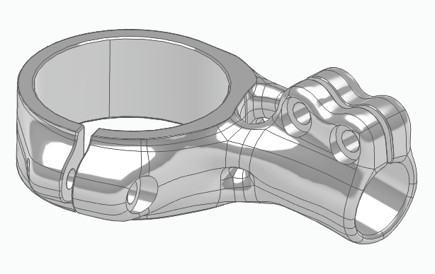
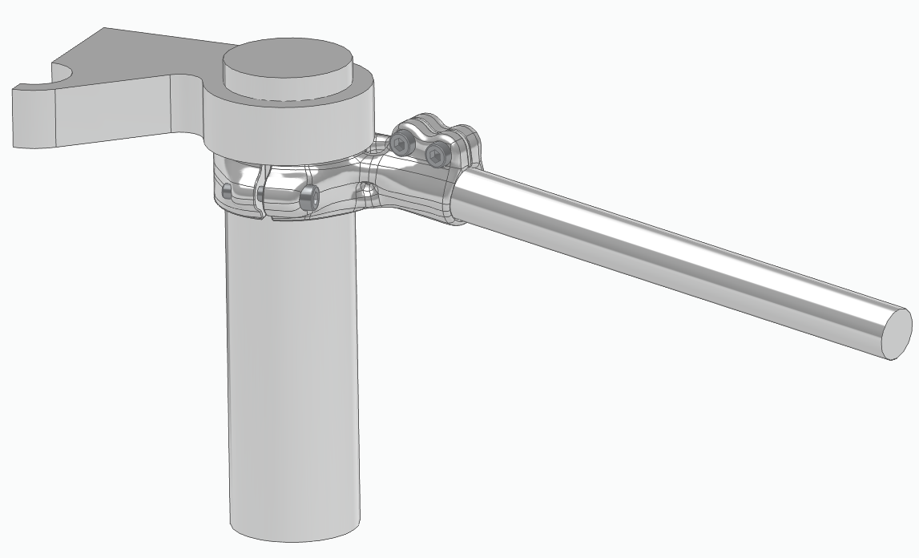
MANUFACTURING PROCESS
Final product and assembly:
Final weight: 132g ✔️

Slide 19
BIBLIOGRAPHY
Fatigue response of AlSi10Mg by laser powder bed fusion: influence of build orientation, heat, and surface treatments. (S. Fini · D. Croccolo · M. De Agostinis · G. Olmi · L. Paiardini · C. Scapecchi · M. Mele)
EOS Aluminum AlSi10Mg Material datasheet
ETIMOS Aluminum datasheet
ASM Aluminum 7000 series characterization
Lezioni di fondamenti e tecnica della progettazione meccanica (D. Croccolo, N. Vincenzi)
Esercizi di costruzioni di macchine e tecnica delle costruzioni meccaniche (D. Coccolo, M. De Agostinis, G. Olmi)
Manuale di Meccanica- HOEPLI (L. Caligaris, S. Fava, C. Tomasello)
Machine elements design and calculation in mechanical engineering: vol.1 (G. Niemann)
VDI 22230 Systematic calculation of high duty bolted joints. Joints with one cylindrical bolt.

Slide 20
THANKS EVERYBODY FOR THE ATTENTION!

